Slide 1
RCD-CM Kickoff – UAF
January 12, 2024

Slide 2
SHARP CCI
Shared Arkansas Research Plan for Community Cyber Infrastructure (SHARP CCI)
Goals
Cyberinfrastructure alignment with DART / ARP
Create a Cyberinfrastructure Plan (CI Plan) at each SHARP CCI institution
Provide “A Day in the Life of a Research Project” use case from SHARP CCI institutions
Timeline
Shortened RCD-CM survey (January – March 2024)
SHARP CCI + DART annual retreat (February 2024)
CI Plans (February - April 2024)
Review Shortened RCD-CM results and CI Plans (May 2024)
Feedback review, data analysis, and documentation (June – July 2024)
Finally report (August 2024)

Slide 3
RCD-CM Overview Video

Slide 4
RCD-CM Overview
Research Computing and Data (RCD) Capabilities Model
The Research Computing and Data (RCD) Capabilities Model allows institutions to assess their support for computationally- and data-intensive research, to identify potential areas for improvement, and to understand how the broader community views Research Computing and Data support.
The Capabilities Model was developed by a diverse group of institutions with a range of support models, in a collaboration among Internet2, CaRCC, and EDUCAUSE with support from the National Science Foundation.
Notes:
https://uark.app.box.com/file/1277890167960

Slide 5
Shortened RCD-CM Overview
Created Shortened RCD-CM due to the scope and complexity
Increase ability to complete the RCD-CM
Still able to compare results to national RCD-CM results
Facing | Shortened | Full
Researcher | 5 | 17
Data | 8 | 29
Software | 8 | 25
Systems | 12 | 57
Strategy and Policy | 7 | 24
Total | 40 | 152

Slide 6
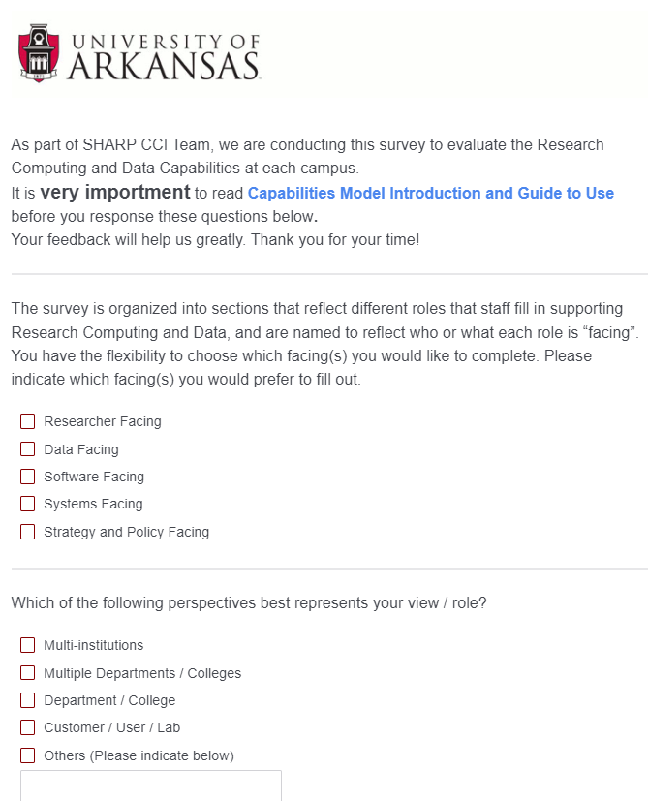
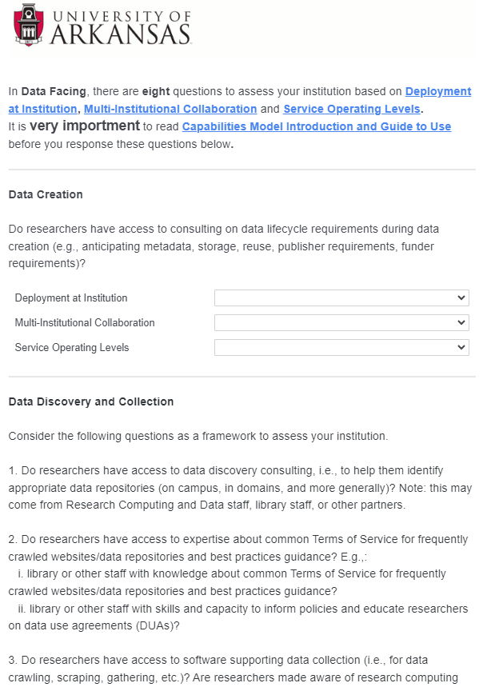
Shortened RCD-CM survey
RCD-CM SURVEY LINK: https://uark.qualtrics.com/jfe/form/SV_09aGmseG54YpUbk

Slide 7
Shortened RCD-CM survey facing
Facing examples
Facing Area | Description | Example roles
Researcher Facing Roles | Includes research computing and data staffing, outreach, and advanced support, as well as support in the management of the research lifecycle. | Research IT User Support, Research Facilitators, CI engineers, etc.
Data Facing Roles | Includes data creation; data discovery and collection; data analysis and visualization; research data curation, storage, backup, and transfer; and research data policy compliance. | Research Data Management specialists, Data Librarians, Data Scientists, etc.
Software Facing Roles | Includes software package management, research software development, research software optimization or troubleshooting, workflow engineering, containers and cloud computing, securing access to software, and software associated with physical specimens. | Research Software Engineers, Research Computing support, etc.
Systems Facing Roles | Includes infrastructure systems, systems operations, and systems security and compliance. | HPC systems engineers, Storage Engineers, Network specialists, etc.
Strategy- and Policy Facing Roles | Includes institutional alignment, culture for research support, funding, and partnerships and engagement with external communities. | Research IT leadership

Slide 8
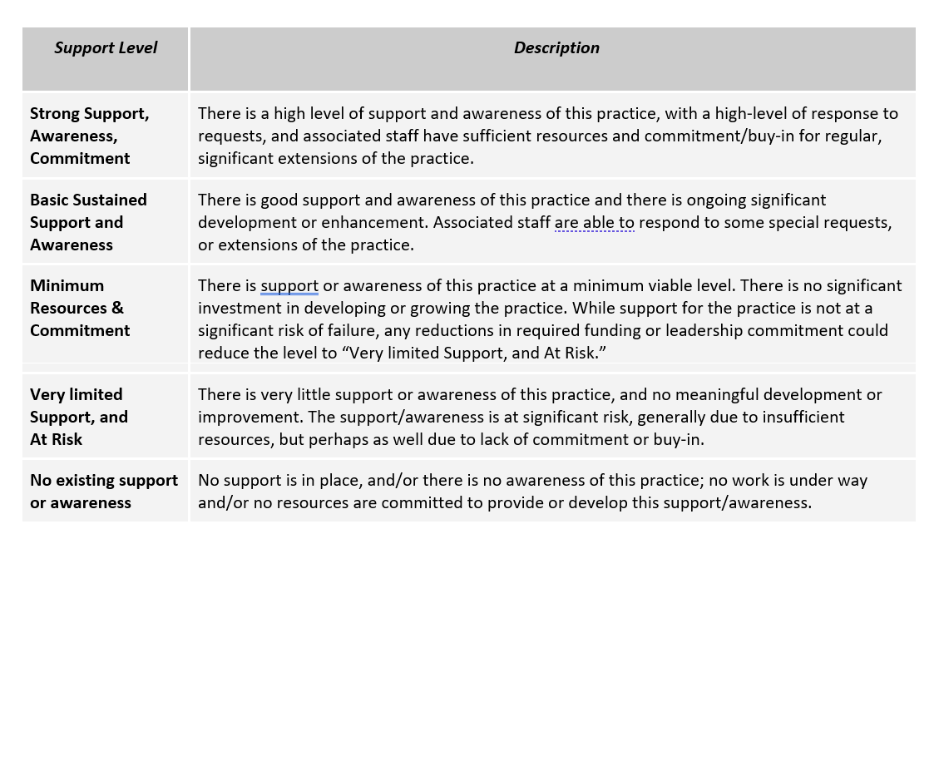
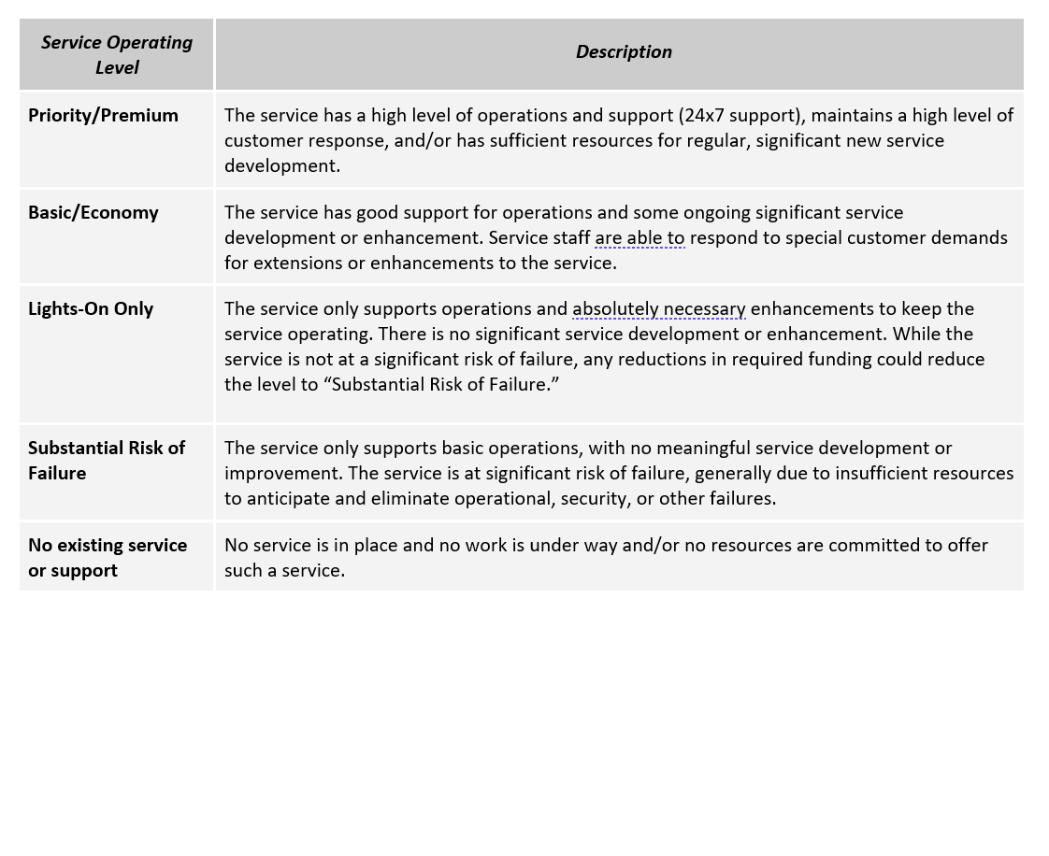
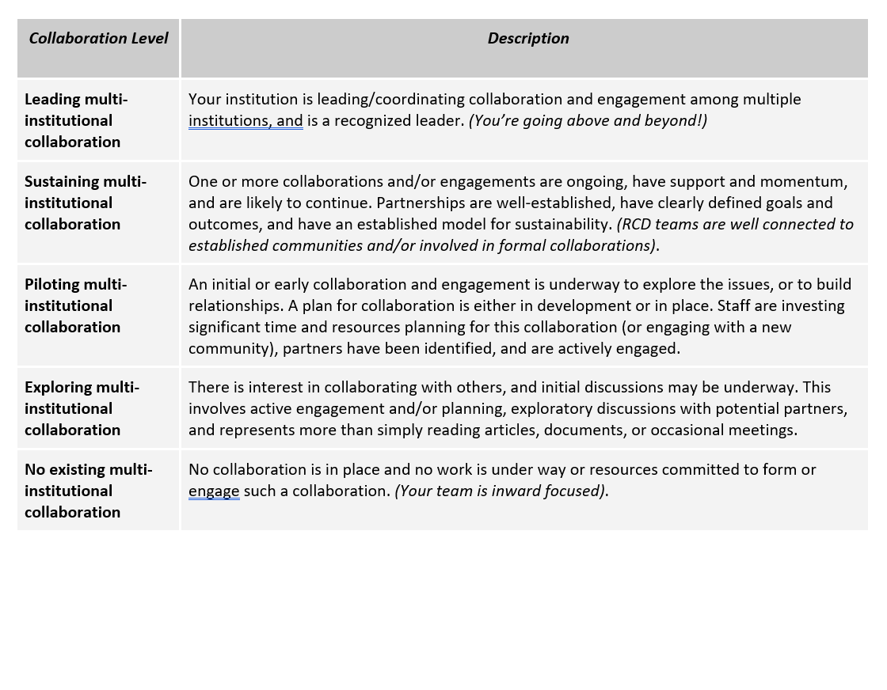
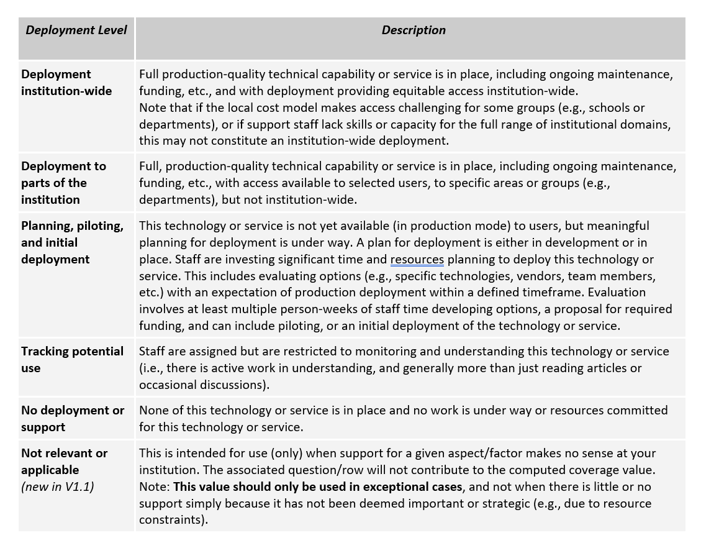
Shortened RCD-CM survey response

Slide 9
Completing the survey
Keep in mind
Resources
Answer from your perspective
Be consistent (High, Average, Low)
No “right” or “wrong” answers
We will share this presentation
Office Hours every Wednesday 10:30 – 11:30am
Schedule dedicated time
Don’t hesitate to reach out

Slide 10
Next steps
You will receive an email with the survey link
Feel free to join Office Hours every Wednesdays 10:30 – 11:30am
We can schedule dedicated time
Don’t hesitate to reach out
We will share your institutions results
Compare to national data
Compare to other SHARP CCI institutions
Shortened RCD-CM will be helpful in developing a CI Plan

